Slide 1


Trafficking & Exploitation Education
Education is Prevention - Knowledge That Protects.
ProtectEd
Trigger Warning: Sensitive Content
Today’s lesson will include discussion about difficult and sensitive topics, including human trafficking, unhealthy relationships, and exploitation. If at any point during the lesson you feel uncomfortable or need a break, you are allowed to step out of the classroom to a safe, designated space.
Instructions:
1. Find your seat
2. Take a copy of the Pre-Assessment from your desk
3. Begin working quietly on the Pre-Assessment
This helps us understand what you already know so we can better support you.
Your answers are private—just do your best!
www.mirrorministries.org

Slide 2
ProtectEd
Education is Prevention — Knowledge That Protects
www.mirrorministries.org

Slide 3
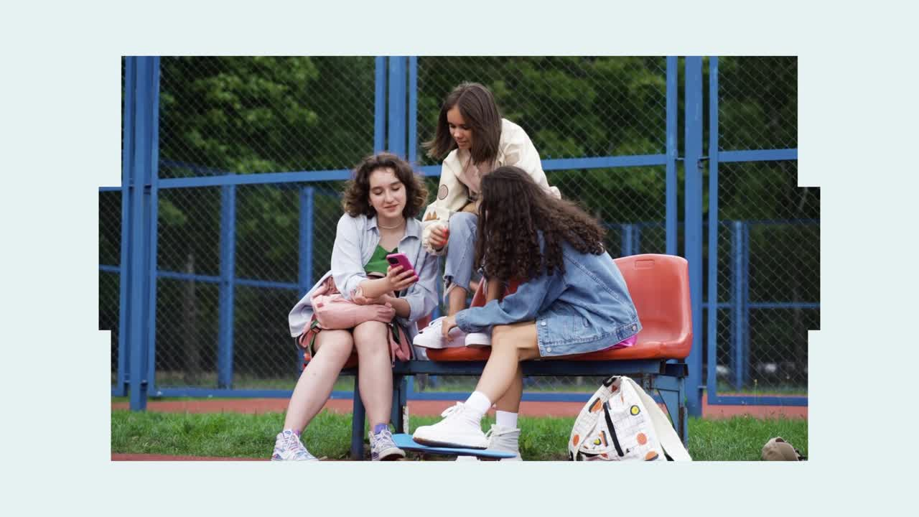
www.mirrorministries.org

Slide 4
Trafficking & Exploitation Education
3
Education is Prevention - Knowledge That Protects.
ProtectEd
Imagine someone your age is promised an opportunity to be an influencer online. They are excited about the opportunity because it is coming from a celebrity or someone they follow. All they have to do (or have already done) is to send a picture and a little personal information… What would you do?”
www.mirrorministries.org

Slide 5
Trafficking & Exploitation Education
4
Education is Prevention - Knowledge That Protects.
ProtectEd
What is Sex Trafficking? (Legal Definition)
  Sex trafficking is when someone makes another person trade sex or sexual images (this is called a commercial sex act) with force, fraud, or coercion (we’ll explain better in depth later).
  This could be for money, gifts, food, or even a place to stay.
www.mirrorministries.org

Slide 6
Trafficking & Exploitation Education
5
Education is Prevention - Knowledge That Protects.
ProtectEd
Commercial Sex Act:
  A commercial sex act is when anything sexual is done in exchange for something of value—like money, food, clothes, rides, shelter, drugs, or even phone data.
  If someone gives you a vape, a new outfit, or a ride home in exchange for nudes or sexual acts, that’s a commercial sex act.
www.mirrorministries.org

Slide 7
Trafficking & Exploitation Education
6
Education is Prevention - Knowledge That Protects.
ProtectEd
The Law Protects Minors:
  No need to prove force, fraud, or coercion — any commercial sex act involving a minor is automatically considered sex trafficking under federal law.
  If you’re under 18, you cannot legally agree to trade sex or sexual images—even if you said yes-it’s still trafficking. You're never to blame.
  If someone sets that up, they are breaking the law. That makes you a victim, not a criminal.
www.mirrorministries.org

Slide 8
Trafficking & Exploitation Education
7
Education is Prevention - Knowledge That Protects.
ProtectEd
Understanding Sex Trafficking
Trafficking doesn’t usually begin with kidnapping or a dramatic event—it happens through a process.
  The goal : to make a young person feel dependent, confused, or obligated so the trafficker can eventually exploit them.
  Traffickers use force, fraud, and coercion to get a person commit a sex act.
www.mirrorministries.org

Slide 9
Trafficking & Exploitation Education
8
Education is Prevention - Knowledge That Protects.
ProtectEd
What is Coercion?
Coercion is a purposeful plan to trap someone into doing things they don’t want to do. They pressure, threaten, or scare you into doing something you don’t want to do.
It can sound like:
  “If you don’t do this, I’ll tell everyone your secret.”
  “I’ll stop helping you if you don’t send that pic.”
  “You owe me, so do this for me.”
www.mirrorministries.org

Slide 10
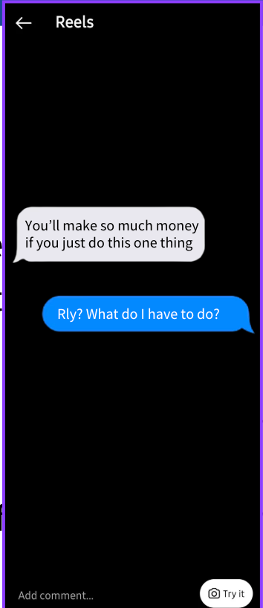
Trafficking & Exploitation Education
9
Education is Prevention - Knowledge That Protects.
ProtectEd
What is Fraud?
Fraud is when someone lies or tricks you to get you to do something.
It can sound like:
  “I can get you a modeling job—just send me pics first.”
  “This is just for fun, no one will ever find out.”
www.mirrorministries.org

Slide 11
Trafficking & Exploitation Education
10
Education is Prevention - Knowledge That Protects.
ProtectEd
What is Force?
Force is when someone uses physical power or threats of physical harm to make a person do something they don’t want to do. It can include hurting someone, threatening to hurt them, or using intimidation or violence to control their actions.
www.mirrorministries.org

Slide 12
Trafficking & Exploitation Education
11
Education is Prevention - Knowledge That Protects.
ProtectEd
Who is at Risk?
Anyone can be at risk, but traffickers often target people who:
  Want to feel loved, seen, or supported
  Spend a lot of time online alone
  Are going through a hard time at home or school
  Need money, food, or a place to stay
  Feel lonely, insecure, or depressed
  Have run away or don’t feel safe at home
Remember: There’s no “type” of person traffickers go after—it can happen to anyone.
www.mirrorministries.org

Slide 13
Trafficking & Exploitation Education
12
Education is Prevention - Knowledge That Protects.
ProtectEd
Who is at Risk? (Continued)
  People from communities with poverty, unstable housing, or limited support
  Youth of color
  Girls and women (although males are heavily targeted as well, particularly online)
  Youth and runaways
  LGBTQ+ youth
Traffickers look to exploit a vulnerability, not necessarily a specific “type” of person — which means no one is completely exempt.
www.mirrorministries.org

Slide 14
Trafficking & Exploitation Education
13
Education is Prevention - Knowledge That Protects.
ProtectEd
Basic Identification
Signs to Look For in Yourself or Friends
  Someone is controlling your choices
  You’re being asked for sexual pictures or sexual favors
  A relationship that feels too intense, too fast
  You feel scared, pressured, or trapped
  Big or sudden changes
  Online situations that feel wrong
www.mirrorministries.org

Slide 15
Trafficking & Exploitation Education
14
Education is Prevention - Knowledge That Protects.
ProtectEd
Trafficker Demographics
Traffickers can be anyone — strangers, peers, adults, or even trusted individuals. There is no single “look” or demographic
  Adults of any gender
  People with close access to youth
  Individuals motivated by power, control, or profit
  People from any socioeconomic status
  Traffickers of all races and ethnicities
Exploitation is about opportunity, not background.
www.mirrorministries.org

Slide 16
Trafficking & Exploitation Education
15
Education is Prevention - Knowledge That Protects.
ProtectEd
Stigmatization
  Means judging or labeling someone in a hurtful way
  Makes victims feel blamed or ashamed
  Can stop them from asking for help or reporting what’s happening
In trafficking, this can be especially harmful—victims may worry others will blame them or think they “chose” what happened.
www.mirrorministries.org

Slide 17
Trafficking & Exploitation Education
16
Education is Prevention - Knowledge That Protects.
ProtectEd
How Do Traffickers Recruit?
Traffickers don’t usually grab people off the street. They use tricks, lies, and fake relationships to build trust first.
www.mirrorministries.org

Slide 18

Trafficking & Exploitation Education
17
Education is Prevention - Knowledge That Protects.
ProtectEd
How Do Traffickers Recruit?
Ways they recruit:
  Flirting online or in person to start a “relationship”
  Sending money, gifts, food, or rides
  Pretending to be a boyfriend/girlfriend, manager, or talent scout
Saying things like:
You’re different. You’re special.
You can make easy money.
I’ll take care of you
This can happen on social media, in real life, or both.
www.mirrorministries.org

Slide 19
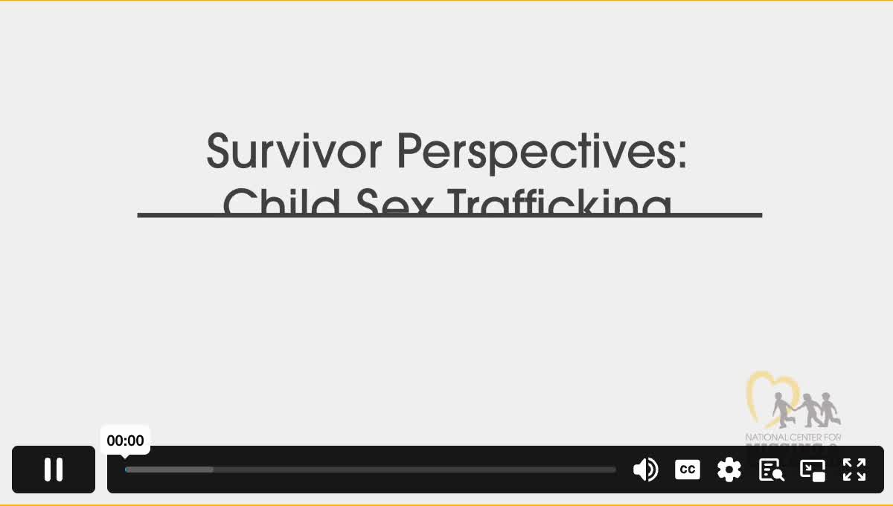
Trafficking & Exploitation Education
18
Education is Prevention - Knowledge That Protects.
ProtectEd
Child Sex Trafficking Vulnerabilities NCMEC
If video isn’t playing, click on link and scroll down to view video
www.mirrorministries.org

Slide 20
Trafficking & Exploitation Education
19
Education is Prevention - Knowledge That Protects.
ProtectEd
Warning Signs:
Behavioral Signs- A friend may be in trouble if they:
  Start talking or dressing in ways that seem very different
  Have money or things they can’t explain
  Seem scared, secretive, or withdrawn
  Lose interest in school, friends, or activities they liked before
  Always check in with someone older before making any move
www.mirrorministries.org

Slide 21
Trafficking & Exploitation Education
20
Education is Prevention - Knowledge That Protects.
ProtectEd
Warning Signs:
Relational Signs- Warning Signs in a Relationship:
  The person is much older or controlling
  They demand nudes or sexual favors in return for gifts or love
  You feel like you owe them or can’t say no
  You’re hiding the relationship from friends or adults
They say things like:
  “If you love me, prove it.”
  “Don’t tell anyone about us.”
www.mirrorministries.org

Slide 22
Trafficking & Exploitation Education
21
Education is Prevention - Knowledge That Protects.
ProtectEd
Online Exploitation and Grooming:
Grooming is when someone builds trust with a young person online in order to manipulate or exploit them later—often for sexual reasons.
It usually happens slowly and might look like:
  Giving compliments: “You’re so mature for your age.”
  Offering gifts or money
  Asking you to keep secrets
  Starting out with innocent talk, then pushing for pics or videos
www.mirrorministries.org

Slide 23
Trafficking & Exploitation Education
22
Education is Prevention - Knowledge That Protects.
ProtectEd
Online Exploitation and Grooming:
Grooming is when someone builds trust with a young person online in order to manipulate or exploit them later—often for sexual reasons.
Saying things like:
  “This is just between us.”
  “You can trust me more than your parents.”
Grooming is how many traffickers and predators start the process of abuse or exploitation.
www.mirrorministries.org

Slide 24
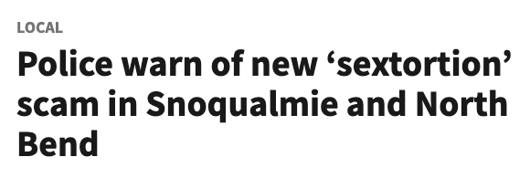
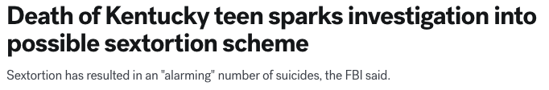

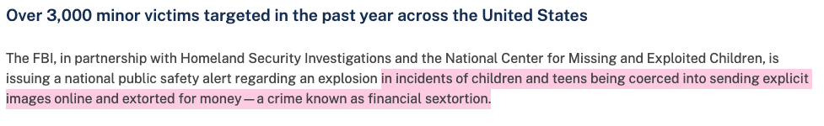



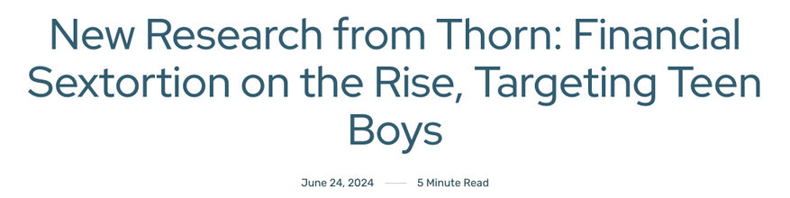
Trafficking & Exploitation Education
23
Education is Prevention - Knowledge That Protects.
ProtectEd
www.mirrorministries.org

Slide 25
Trafficking & Exploitation Education
24
Education is Prevention - Knowledge That Protects.
ProtectEd
High-Risk Platforms for Grooming and Exploitation:
These apps and games are often used by predators and traffickers to connect with teens because of private messaging, photo sharing, or anonymous chatting:
  Instagram
  Snapchat
  TikTok
  Facebook/FB Messenger
  Reddit
6. Roblox
7. Discord
8. Fortnite
9. Minecraft (with 3rd party servers)
10. Omegle
These platforms aren’t “bad”—but traffickers use them to start conversations, especially when no one is watching.
www.mirrorministries.org

Slide 26
Trafficking & Exploitation Education
25
Education is Prevention - Knowledge That Protects.
ProtectEd
What Grooming Looks Like in Real Life:
Grooming often doesn’t look scary at first—it looks like friendship, flirting, or fun. Here’s how it might show up:
  Someone you met on Snapchat keeps messaging, even if you stop replying
  A person online asks for a pic “just for them” and says, “I won’t show anyone”
  A gamer offers you game credits or skins if you send a video or talk dirty
  Someone starts off as a “friend,” but gets controlling or sexual over time
  They ask you to hide the relationship from your parents or friends
  They flip—they're super nice, then suddenly threaten or guilt you
www.mirrorministries.org

Slide 27
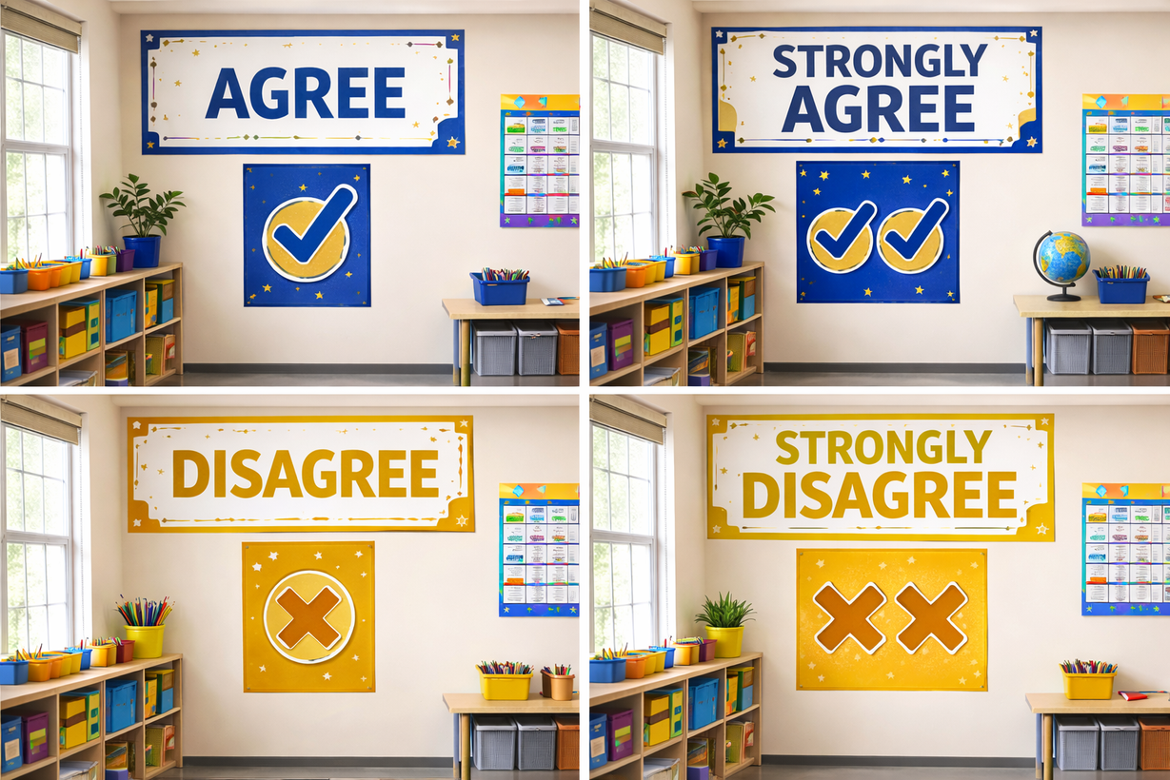
Trafficking & Exploitation Education
26
Education is Prevention - Knowledge That Protects.
ProtectEd
Pick A Corner Activity
www.mirrorministries.org

Slide 28

Trafficking & Exploitation Education
27
Education is Prevention - Knowledge That Protects.
ProtectEd
Safety Quest: Real World Mode Quiz Activity
www.mirrorministries.org

Slide 29

Trafficking & Exploitation Education
28
Education is Prevention - Knowledge That Protects.
ProtectEd
ProtectEd Post-Assessment Reflection Prompt
  Before you leave today, please complete the Post-Assessment on your desk and turn it in—your honest answers help us understand what you’ve learned and how we can improve.
  Your thoughts matter—thanks for sharing them to keep you and your friends protected.
www.mirrorministries.org

Slide 30
ProtectEd
Education is Prevention — Knowledge That Protects
www.mirrorministries.org

